Slide 1
BA Training Day 9

Slide 2

Agile, Scrum, Sprint
SCRUM team, SCRUM Master, Product Owner responsibilities
Story Boarding, SCRUM Planning, Sprint Planning, Story Grooming all with examples
An overview of all terms important in an Agile/SCRUM process.
Product Backlog

Slide 3
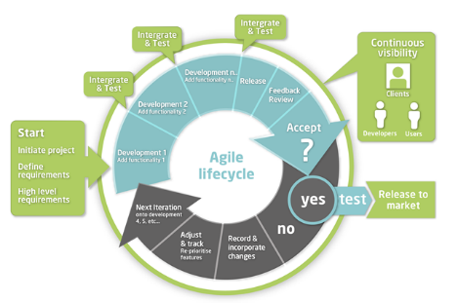

Slide 4
What Is a Agile?
Agile SDLC model is a combination of iterative and incremental process models with focus on process adaptability and customer satisfaction by rapid delivery of working software product. Agile Methods break the product into small incremental builds. These builds are provided in iterations. Each iteration typically lasts from about one to three weeks. Every iteration involves cross functional teams working simultaneously on various areas like −
Planning - Requirements Analysis – Design – Coding - Unit Testing and Acceptance Testing.

Slide 5
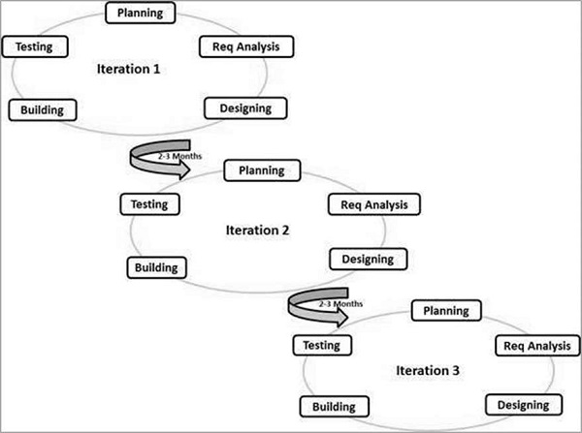
Agile Model

Slide 6
What Is a Agile?
At the end of the iteration, a working product is displayed to the customer and important stakeholders.
Agile model believes that every project needs to be handled differently and the existing methods need to be tailored to best suit the project requirements. In Agile, the tasks are divided to time boxes (small time frames) to deliver specific features for a release.
Iterative approach is taken and working software build is delivered after each iteration. Each build is incremental in terms of features; the final build holds all the features required by the customer.

Slide 7
Scrum
Scrum is a management and control process that cuts through complexity to focus on building products that meet business needs. Management and teams are able to get their hands around the requirements and technologies, never let go, and deliver working products, incrementally and empirically.
Scrum is simple. It is the opposite of a big collection of interwoven mandatory components. Scrum is not a methodology. Scrum implements the scientific method of empiricism. Scrum replaces a programmed algorithmic approach with a heuristic one, with respect for people and self-organization to deal with unpredictability and solving complex problems.

Slide 8
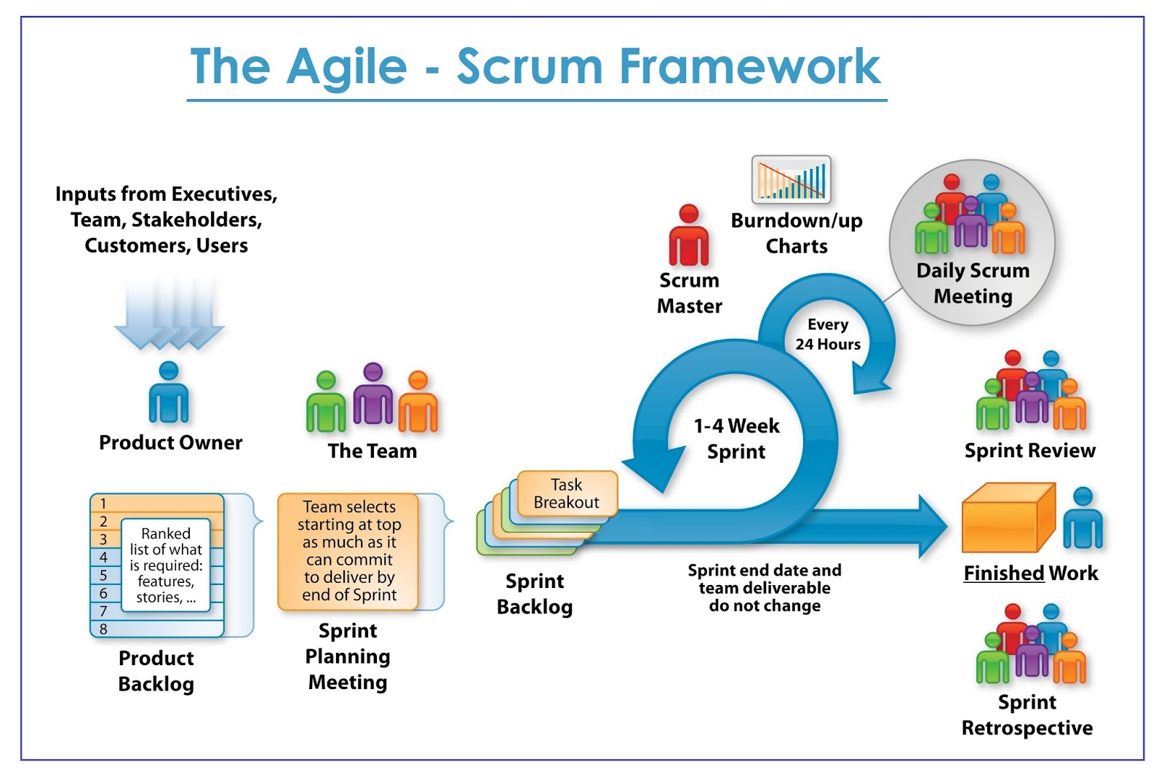
Scrum Team

Slide 9
Scrum
A product owner creates a prioritized wish list called a product backlog.
During sprint planning, the team pulls a small chunk from the top of that wish list, a sprint backlog, and decides how to implement those pieces.
The team has a certain amount of time — a sprint (usually two to four weeks) — to complete its work, but it meets each day to assess its progress (daily Scrum).
Along the way, the ScrumMaster keeps the team focused on its goal.
At the end of the sprint, the work should be potentially shippable: ready to hand to a customer, put on a store shelf, or show to a stakeholder.
The sprint ends with a sprint review and retrospective.
As the next sprint begins, the team chooses another chunk of the product backlog and begins working again.

Slide 10
Sprint
In product development, a sprint is a set period of time during which specific work has to be completed and made ready for review.
Each sprint begins with a planning meeting. During the meeting, the product owner (the person requesting the work) and the development team agree upon exactly what work will be accomplished during the sprint.
The development team has the final say when it comes to determining how much work can realistically be accomplished during the sprint, and the product owner has the final say on what criteria need to be met for the work to be approved and accepted.

Slide 11
Sprint
The duration of a sprint is determined by the Scrum Master, the team's facilitator. Once the team reaches a consensus for how many days a sprint should last, all future sprints should be the same. Traditionally, a sprint lasts 30 days.
After a sprint begins, the product owner must step back and let the team do their work. During the sprint, the team holds daily stand up meeting to discuss progress and brainstorm solutions to challenges. The project owner may attend these meetings as an observer but is not allowed to participate unless it is to answer questions. (See Pigs & Chicken). The project owner may not make requests for changes during a sprint and only the Scrum Master or project manager has the power to interrupt or stop the sprint.
At the end of the sprint, the team presents its completed work to the project owner and the project owner uses the criteria established at the sprint planning meeting to either accept or reject the work.

Slide 12
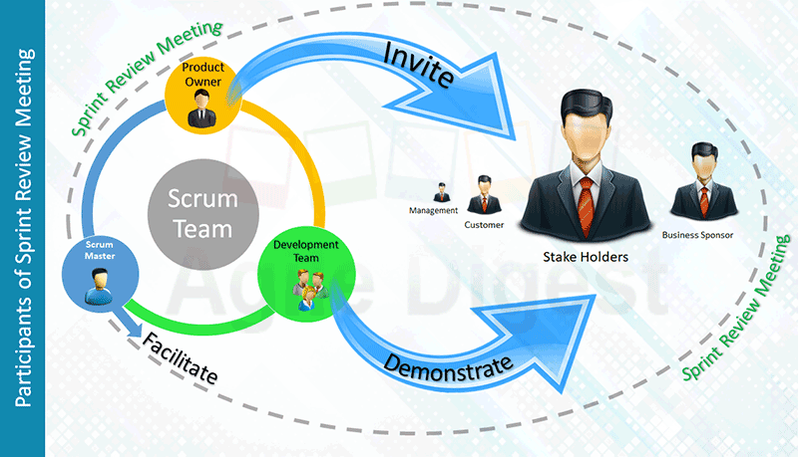

Slide 13
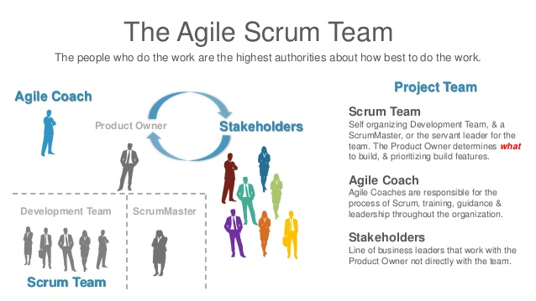

Slide 14
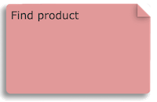
Story Boarding
Story boarding is a top-down approach of requirement gathering and is represented as a tree. Story mapping starts from an overarching vision. A vision is achieved via goals. Goals are reached by completing activities. And to complete an activity, users needs to perform tasks. And these tasks can be transformed into user stories for software development.
Lets take an example of an online store application’s one of the goal ‘Find product’ and build a branch of a story map to understand it better,

Slide 15
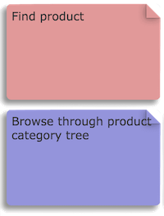
Story Boarding
To achieve goal ‘Find product’ there are multiple ways such as ‘Browse through product category tree’, ‘Free text search’, ‘Promoted products’. Lets take one approach ‘Browse through product category tree’ to build our story map,

Slide 16
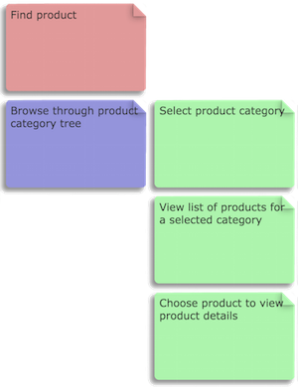
Story Boarding
Now to complete activity of reaching a required product, user needs to do perform certain tasks,

Slide 17
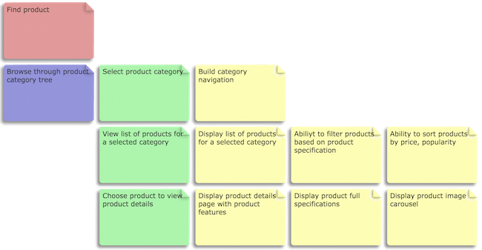
Story Boarding
Now this tasks can be converted to user stories for software development,

Slide 18
Story Boarding
Like this continue to deep dive each branch of the story map starting from goals and build the whole story map. In my experience building full story map takes from 3 days to 2 weeks based on project size and complexity.

Slide 19

Sprint Planning
The Iteration or Sprint Planning meeting is for team members to plan and agree on the stories or backlog items they are confident they can complete during the sprint and identify the detailed tasks and tests for delivery and acceptance.
Iteration lengths typically range between 1 and 4 weeks. The team holds a planning meeting at the beginning of each iteration to break down each of the features scheduled for the iteration into specific technical tasks. Iteration or agile sprint planning meetings generally last from 2-4 hours – any more than that and
you may be spending too much
time in unnecessary planning;
less time than that and you may not
be doing enough planning and collaborating.

Slide 20
Feature Selection
Many teams set an overall goal for the iteration to help guide the selection of features. At the beginning of the meeting, the highest priority features are typically selected from the release plan. If the iteration does have an overarching goal, then some lower priority features may be selected if they better align with the goal. Prior velocity is critical to enabling the team to schedule a realistic amount of work.
For example, if the team previously planned to get 40 story points worth of product features, but only successfully delivered 30 story points, then 30 story points should be considered the current velocity for the next iteration. Past velocity estimates compared to actual numbers are useful at the iteration level, the feature level, and the task level. All of these help the team determine how much they can sign up for in the next iteration. If the iteration is overbooked, then the customer needs to select which features need to be delayed to a future iteration. During the iteration planning meeting, the customer will discuss features with the team and attempt to answer any questions the team has.

Slide 21
Task Planning
The team will break the features down into tasks. Developers then sign up for tasks and estimate them. Tasks typically range in size from 4 hours to 2 days, with most tasks capable of being delivered within a day. Tasks larger than 2 days should generally be broken down into smaller tasks.
Occasionally during task planning a feature is determined to be have been woefully underestimated in the original release plan. In this case, the team will need to work with the customer on providing a corrected estimate and determining what feature or features may need to be delayed as a result.

Slide 22
Iteration Adjustments
During the iteration, if there is remaining time after all features have been delivered, then the team can request that the customer identify additional feature(s) to add to the iteration.
If, on the other hand, it is obvious that not all features can be delivered, then the team works with the customer to determine which features could be delayed or perhaps split in order to deliver the most value by the iteration deadline.

Slide 23
Warning Signs
If over a series of iterations, the team continues to push features out into the future, it is a sign that the team should pay closer attention to its prior velocity in order to minimize continuous overbooking and maximize planning accuracy.
If the team keeps pushing the same features forward each iteration, it may be a signal that the team is purposely avoiding certain functionality and the root causes should be explored.
If the team is diving into too much detail and designing each feature in full, there may be an opportunity for increased focus on identifying the task work thats necessary.

Slide 24
Sprint Meeting Outcome
The Sprint Review meeting is primarily establish a feedback loop for any scrum team. Which always helps the team to improve on quality, process, and value.
There are many direct indirect benefits and outcome of sprint review meeting. I mentioned below most of them.
Increment Inspection & adaptive backlog: to support the empirical model of agile inspection is very important, here in this meeting, the functionality increments gets inspected, result to a adaptive product backlog.
Improve Collaboration: The team get chance to interact with business user and stakeholders, that motivates the team and increase the visibility on the product they are working on.

Slide 25
Sprint Meeting Outcome
Transparent Business Vision : The team get familiar with the vision of the business user and the gets more clarity of the result of the the work they are doing or about to do.
Up to date prioritized Backlog : Re-prioritization helps the team pick the best story for the sprint, that will create the maximum value to the product and business.
New Backlog Items : This meeting may hatch new product backlog item, to cater with dynamic market trend and competition.
Team Motivation by Appreciation : Praise of team member by Name motivates the team. and a motivated team always good for self organization and best output.

Slide 26
Post Sprint Meeting
Once the Sprint Review meeting is over, Its a good practice to do few activities like as below.
Meeting of Minutes : Its always a good practice to send a meeting summary, Scrum Master can circulate a meeting of minutes to all participants and also to the person invited or involved but unable to attend the meeting.
The summary can include, All story demonstrated, New Backlog Item Introduced, the change in business vision if any. The details of new priority, mention the team member appreciated and for what.

Slide 27
Post Sprint Meeting
New Backlog Item : Product Owner to create user stories in product backlog. and based on the decided priority reorganized them in backlog. If those stories are on immediate need, Scrum Master can schedule a adhoc grooming session, to mature the requirement, and team can estimate the size.
Generally its use to be the next day scheduled for sprint planning meeting, so if there are some functionalities identified for the next sprint, those functionalities must be available with all necessary details to meet the “definition of ready” as a form of user story in Product Backlog. So that it can be commit in sprint planning meeting next day.

Slide 28
Post Sprint Meeting
Re-prioritize : In case of some stories got higher priority as a result of sprint review, those stories may needs grooming to meet the “definition of ready” to plan for next sprint. and also needs grooming.
Sprint Closure Report : This is optional and not directly related with sprint review meeting. Ideally sprint review meeting happens as a last ceremony of the sprint, some times after Retrospective meeting. So its always a good practice to collaborate your sprint accomplishment as closure report, once your sprint and all its associate ceremonies are over. I will explain on all the Agile reports on some other article.

Slide 29
Story Grooming
Another way to reduce the duration is to hold regular backlog refinement or grooming meetings. This will ensure the team has a shared understanding of the most important Product Backlog Items. If the grooming meeting is done regularly, this will reduce the burden from the sprint planning session. So in sprint planning session, team only needs to decide how many of these Product Backlog items they pull into the Sprint.
Longer sprint planning meeting is something which frustrates the team, this is something which SM should avoid.
Two hours per week is good, but if the team still think that its way too long then it should be reduced to the desired time from the team.
Dividing it into the pre-grooming meeting is a good idea or having multiple short meeting with the smaller group of team members, strictly inviting the people really needed in the meeting.

Slide 30
Story Grooming
Timebox style, allocating maximum 3–5 min per User story, have a stopwatch handy to calculate time, if discussion goes out of 5 min, then stop discussing it further move on to another user story
Putting time budget per user story helped a lot and team give full energy to provide valuable input because of time pressure and unnecessary input/discussion left outside the meeting room.
This also put pressure on Product owner, that (s)he enters the room with very defined user stories, and he should know the answer to all the question that developer would have asked. Which mean that (s)he put himself in the role of a user to find those question and have those answers ready.

Slide 31
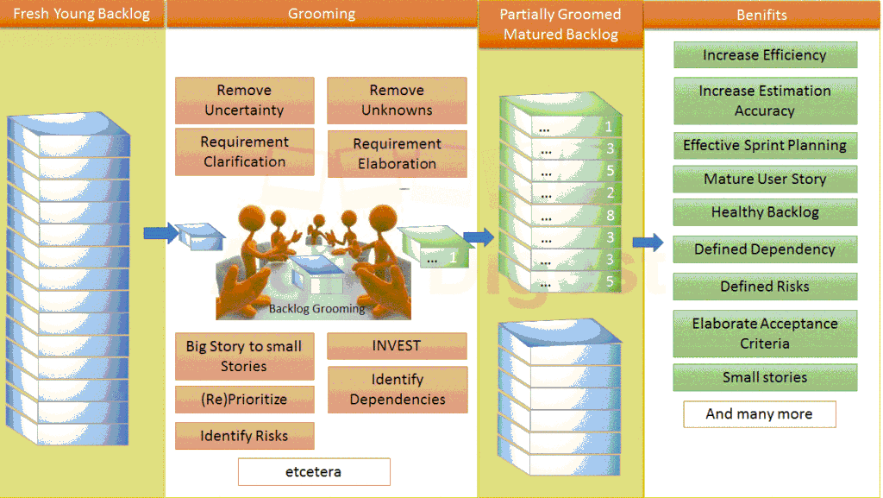

Slide 32
Why Story Grooming?
There are many advantages of product backlog grooming, few of them are listed below.
Increase efficiency by removing uncertainty and unknown facts of a user story.
Identify the Dependencies (within Team and Cross functional) and Risks in advance to plan accordingly.
Better estimation and Avoid rework (development, testing and implementation)
Gives a clarity to developer and Tester about its requirement that saves time to the development team for further discussion during sprint cycle.
Ensuring a story is following INVEST, which gives a better sense mature user story

Slide 33
Why Story Grooming?
Effective Sprint Planning: by focusing on only planning during Sprint planning ceremony. If the stories are Groomed and prioritized at the time of sprint planning PO or Dev team need not to spend much time to groom or estimate the story.
Enforce 1st level of Prioritization to pick stories for grooming, planning etc.
Provide one or many chances to the product Owner / Business Analyst / Story author to enhance the requirements with more information if required.
During Grooming if the Development team encounter some doubts or questions and that needs more time for the POs to colaborate, then the team can park the story from that grooming session so that PO/SA/BA can update the story with more required information and cover the story on subsequent Grooming session.
Better management of Product Goal, Sprint Goal and milestone meeting.

Slide 34
Glossary of Terms
E
Emergence: the process of the coming into existence or prominence of new facts or new knowledge of a fact, or knowledge of a fact becoming visible unexpectedly.
Empiricism: process control type in which only the past is accepted as certain and in which decisions are based on observation, experience and experimentation. Empiricism has three pillars: transparency, inspection and adaptation.
Engineering standards: a shared set of development and technology standards that a Development Team applies to create releasable Increments of software.
F
Forecast (of functionality): the selection of items from the Product Backlog a Development Team deems feasible for implementation in a Sprint.

Slide 35
Glossary of Terms
I
Increment: a piece of working software that adds to previously created Increments, where the sum of all Increments -as a whole - form a product.
P
Product Backlog: an ordered list of the work to be done in order to create, maintain and sustain a product. Managed by the Product Owner.
Product Backlog refinement: the activity in a Sprint through which the Product Owner and the Development Team add granularity to the Product Backlog.
Product Owner: the role in Scrum accountable for maximizing the value of a product, primarily by incrementally managing and expressing business and functional expectations for a product to the Development Team(s).
R
Ready: a shared understanding by the Product Owner and the Development Team regarding the preferred level of description of Product Backlog items introduced at Sprint Planning.

Slide 36
Glossary of Terms
S
Scrum: a framework to support teams in complex product development. Scrum consists of Scrum Teams and their associated roles, events, artifacts, and rules, as defined in the Scrum GuideTM.
Scrum Board: a physical board to visualize information for and by the Scrum Team, often used to manage Sprint Backlog. Scrum boards are an optional implementation within Scrum to make information visible.
Scrum Guide™: the definition of Scrum, written and provided by Ken Schwaber and Jeff Sutherland, co-creators of Scrum. This definition consists of Scrum’s roles, events, artifacts, and the rules that bind them together.
Scrum Master: the role within a Scrum Team accountable for guiding, coaching, teaching and assisting a Scrum Team and its environments in a proper understanding and use of Scrum.

Slide 37
Glossary of Terms
Scrum Team: a self-organizing team consisting of a Product Owner, Development Team and Scrum Master.
Scrum Values: a set of fundamental values and qualities underpinning the Scrum framework; commitment, focus, openness, respect and courage.
Self-organization: the management principle that teams autonomously organize their work. Self-organization happens within boundaries and against given goals. Teams choose how best to accomplish their work, rather than being directed by others outside the team.
Sprint: time-boxed event of 30 days, or less, that serves as a container for the other Scrum events and activities. Sprints are done consecutively, without intermediate gaps.
Sprint Backlog: an overview of the development work to realize a Sprint’s goal, typically a forecast of functionality and the work needed to deliver that functionality. Managed by the Development Team.
Sprint Goal: a short expression of the purpose of a Sprint, often a business problem that is addressed. Functionality might be adjusted during the Sprint in order to achieve the Sprint Goal.

Slide 38
Glossary of Terms
Sprint Planning: time-boxed event of 8 hours, or less, to start a Sprint. It serves for the Scrum Team to inspect the work from the Product Backlog that’s most valuable to be done next and design that work into Sprint backlog.
Sprint Retrospective: time-boxed event of 3 hours, or less, to end a Sprint. It serves for the Scrum Team to inspect the past Sprint and plan for improvements to be enacted during the next Sprint.
Sprint Review: time-boxed event of 4 hours, or less, to conclude the development work of a Sprint. It serves for the Scrum Team and the stakeholders to inspect the Increment of product resulting from the Sprint, assess the impact of the work performed on overall progress and update the Product backlog in order to maximize the value of the next period.
Stakeholder: a person external to the Scrum Team with a specific interest in and knowledge of a product that is required for incremental discovery. Represented by the Product Owner and actively engaged with the Scrum Team at Sprint Review.

Slide 39
Glossary of Terms
V
Velocity: an optional, but often used, indication of the average amount of Product Backlog turned into an Increment of product during a Sprint by a Scrum Team, tracked by the Development Team for use within the Scrum Team

Slide 40
Product Backlog
A product backlog is a prioritized list of work for the development team that is derived from the roadmap and its requirements. The most important items are shown at the top of the product backlog so the team knows what to deliver first. The development team doesn't work through the backlog at the product owner’s pace and the product owner isn't pushing work to the development team. Instead, the development team pulls work from the product backlog as there is capacity for it, either continually (kaban) or by iteration (scrum).
Example

Slide 41


